Slide 1
A Learning Ecosystem to meet Industry Revolution 4.0
Joseph Goh
Founder, Eknowvation

Slide 2
Biography
20 years experience in Learning, Research, and Digital Publishing Technologies
Started IG Publishing - an Academic Digital Publishing platform that serves over 1000 Universities globally with over 15 million users.
Board member of Startup company, Dynolib, that specializes in monitoring of Online Academic Resources
Founder of Eknowvation, a company that focus on providing Effective Research and Learning solutions

Slide 3
What is the Problem?
Knowledge Gap : Theoretical vs Practical
Many Universities and Colleges may not prepare students adequately for the workforce .. Soft-skills, Life-skills, etc
Insufficient Subject Matter Experts in the University
Classroom-based learning is Not Scalable

Slide 4
Question
How to deliver the latest required knowledge or skill to a wide audience across the country … efficiently and economically?

Slide 5
Rethinking the Learning Platform
Traditional LMS is no longer good enough to meet modern needs
Industry is moving much faster the Academic Learning
Modern Learning Platforms will grow with Industry
Deliver external courses to students to increase their employability
Allow Faculties to promote and deliver courses to external learners
Leverage on Social Learning to increase engagement and improve learning
Focus of Lifelong Learning

Slide 6
Case Studies

Slide 7
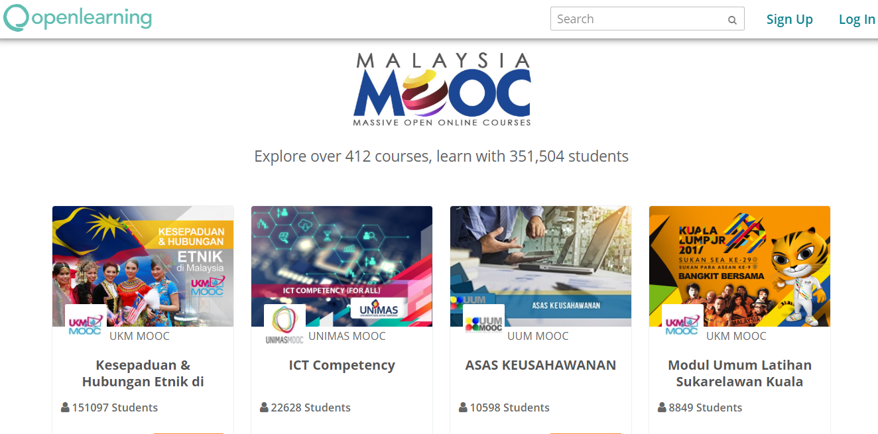
Malaysia MOOC:
Transforming Higher Education
World’s first national MOOC program, launched in 2014 involving all 20 public universities and 34 public polytechnics in Malaysia.
Over 350,000 students have enrolled in one of 412 courses through Malaysia MOOC, delivered entirely through OpenLearning.
OpenLearning works with the Malaysian Ministry of Education, various committees and academics.

Slide 8
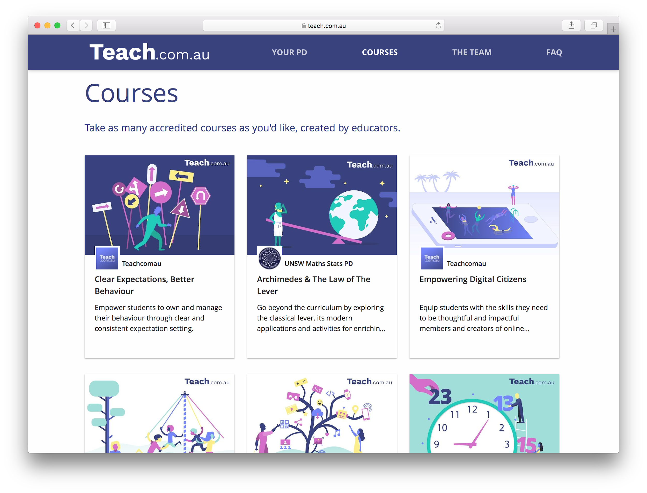
Teach.com.au: Accredited Teacher Training
Unlimited access to the highest quality NESA accredited online teacher training courses for A$190/year.
Australian market has 310,000 full-time teachers and 125,000 casual teachers - average spend of $700/teacher/year on teacher Professional Development.
Project conceptualised, implemented and marketed by OpenLearning within 8 months, including NSW NESA accreditation.

Slide 9
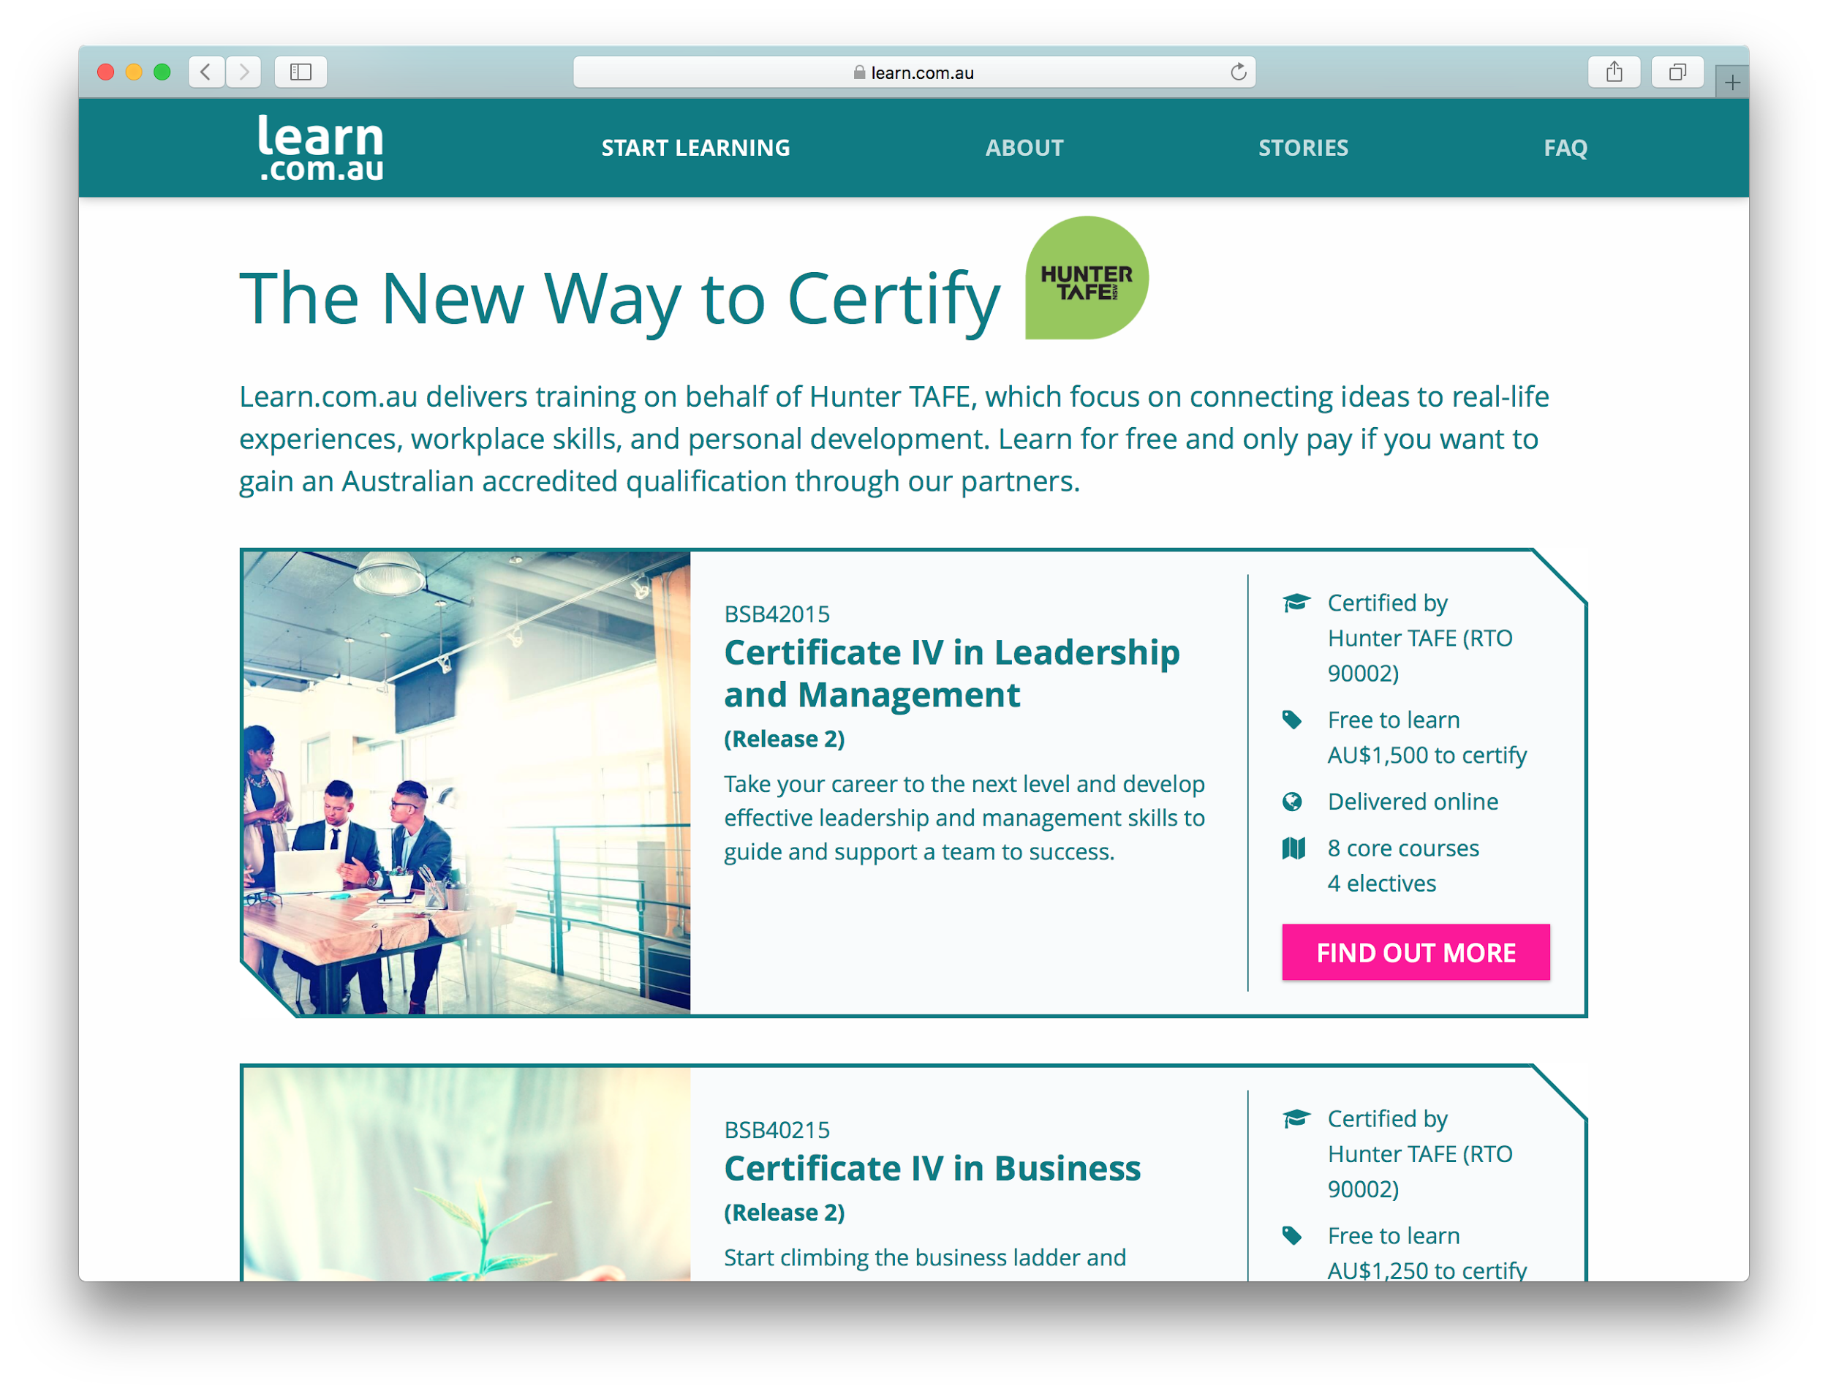
Learn.com.au:
Increasing Access to TAFE NSW
Partnership between TAFE NSW (Hunter Institute), IBSA and OpenLearning to provide VET under a ‘free to learn, pay to certify’ model
Three qualifications: Cert IV Leadership & Management, Small Business Management and Business.
Project conceptualised, implemented and launched by OpenLearning within 10 months from commencement.

Slide 10
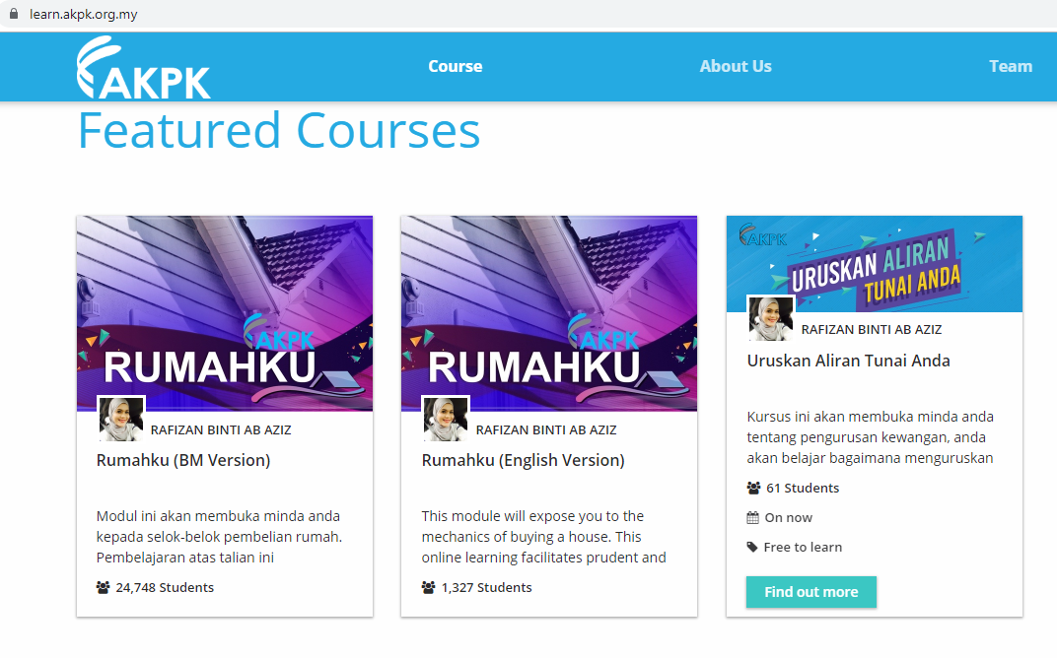
AKPK: Financial Literacy and Awareness at Scale
Agensi Kaunseling and Pengurusan Kredit (AKPK) is an agency under Malaysia’s Central Bank (BNM) that help individuals take charge of their finances.
In line with BNM’s home ownership initiative, AKPK launched a programme on OpenLearning’s platform to teach financial management and responsible borrowing to loan applicants.
AKPK reached >29,000 people in 5 months:
Respective people are educated on financial tools
Increase visibility of AKPK
Speed to scaled increase exponentially
Cost to deliver training reduced significantly

Slide 11
Future Proofing Learning and Workforce Development
Q&A

